Slide 1


Kestrel Bank
AML Detection
Find 4.4x More Suspicious Cases Without Hiring More Investigators
PRESENTED BY
Ryan McClain

Slide 2
Adaptive Alert Ranking
Kestrel Bank
WHAT WE SHOULD DO
Replace the outdated rules based alert ranking with an AI powered Machine learning model that uses account behavior, network relationships, and monthly retraining to prioritize suspicious activity.
ADAPTIVE ALERT MODEL
TRADITIONAL RULES BASED MODEL
ENHANCES DETECTION
DETECTS SIGNIFICANTLY LESS
716 CASES IDENTIFIED
163 CASES IDENTIFIED
Identified 10.44% of laundering using 50 reviews per day
Identified 2.38% of laundering using 50 reviews per day

Slide 3

Why this matters
Kestrel Bank
FINANCIAL PENALTIES AND COMPLIANCE COSTS
Analyst labor is the largest cost in financial crime compliance, about $61B a year across U.S. and Canadian banks
Weak monitoring is a regulatory exposure: TD Bank paid about $3B in October 2024 after 92% of its transaction volume went unmonitored

Slide 4
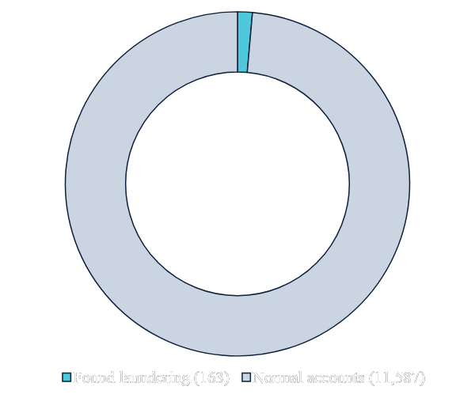
98.6% of Today's Reviews Find Nothing
THE COST OF TODAY'S RULES-BASED REVIEWS
REVIEWS SENT BY THE RULES
11,750
235 days at 50 a day
1.4%
found laundering
ANALYST TIME SPENT
≈$290K
7,250 hours of review time
COST PER CASE FOUND
$1,778
The number the model has to beat
Jan–Aug 2023, 50 reviews a day · Assumes 37 minutes per review at $40/hour
Notes:
Over eight months, the rules sent investigators 11,750 cases. Only 163 were laundering, so 98.6% of reviews found nothing. That's about $1,778 of analyst time for every case found, and that's the number the model has to beat.

Slide 5
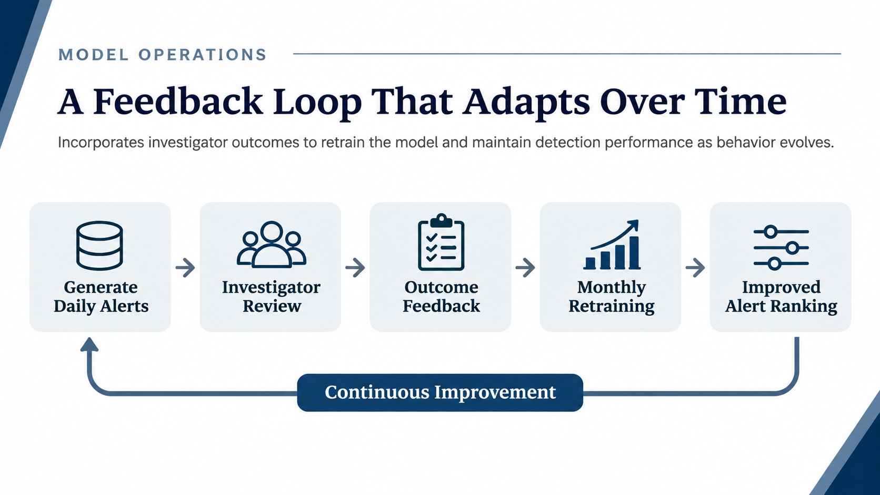

Slide 6
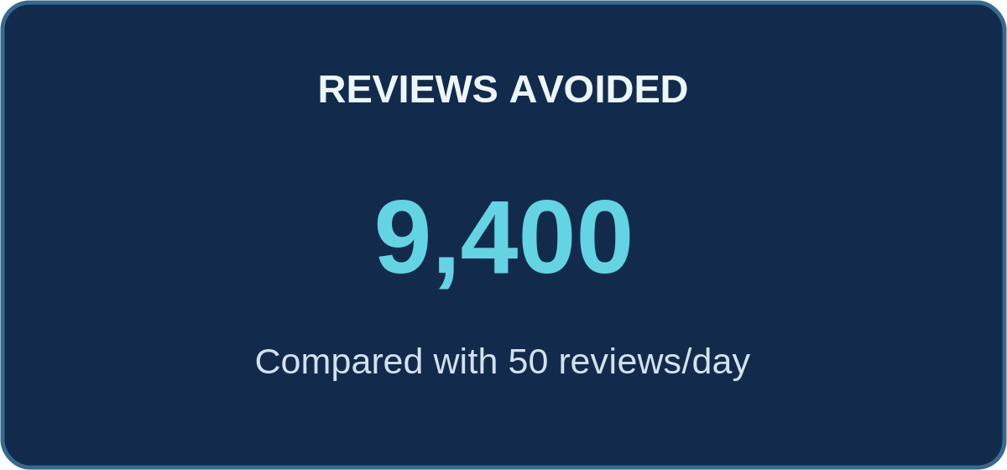
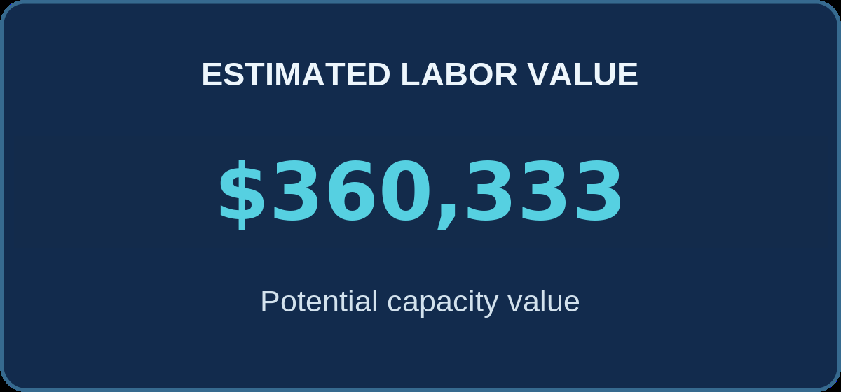
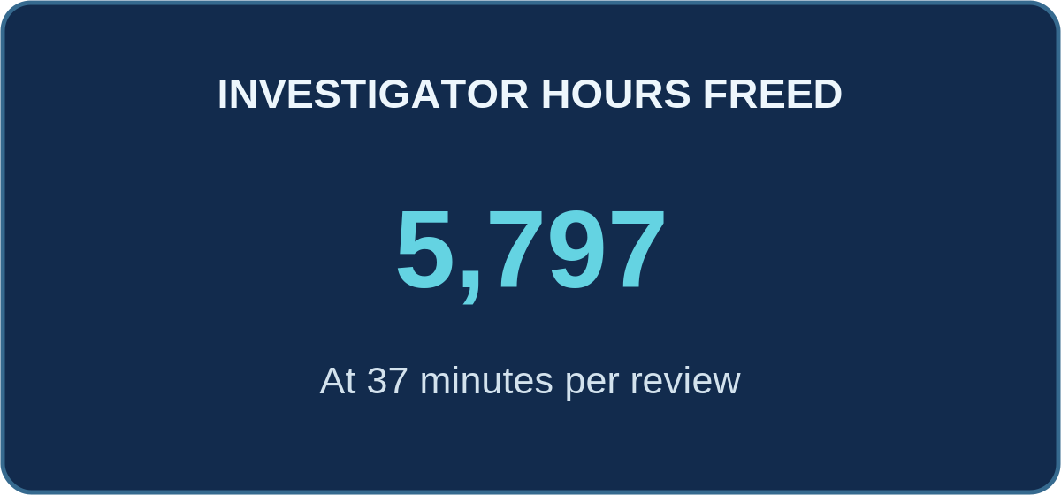
Adaptive Alert Ranking Could Free Up to $360,333 Per Year
Kestrel Bank
716
589
465
377
339
Rules at
50/day: 163
236
170
8
10
15
20
30
40
50
Reviews per day

Slide 7
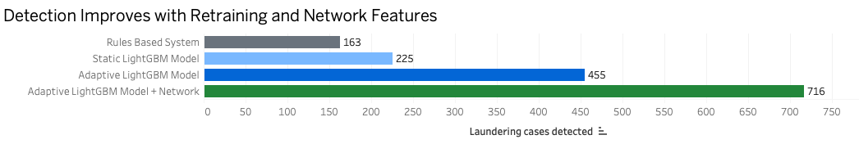
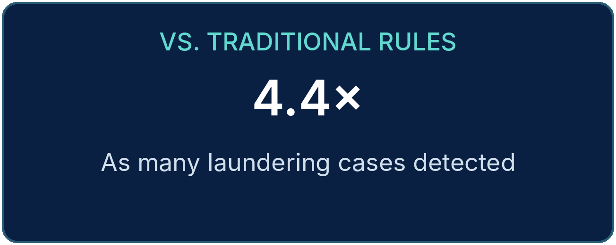
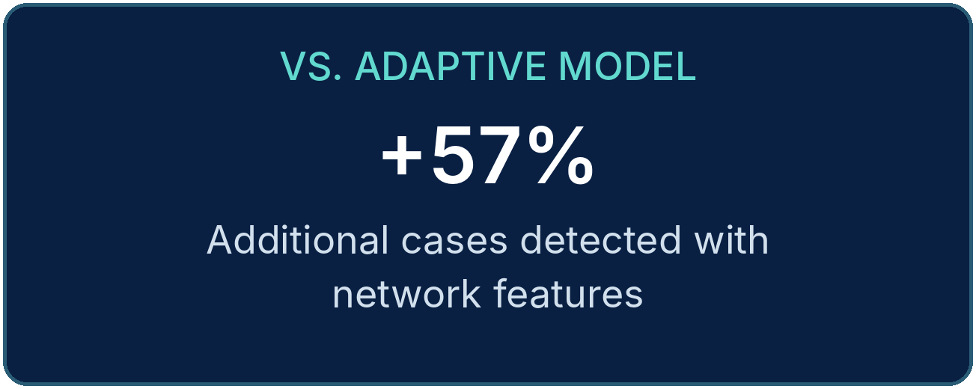
Adaptive Alerts with Network Features Far Outperformed Other Models
Kestrel Bank

Slide 8
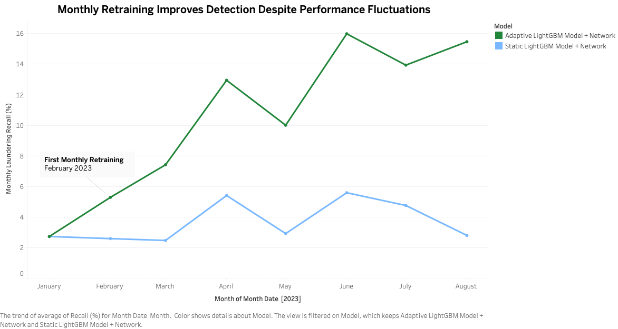
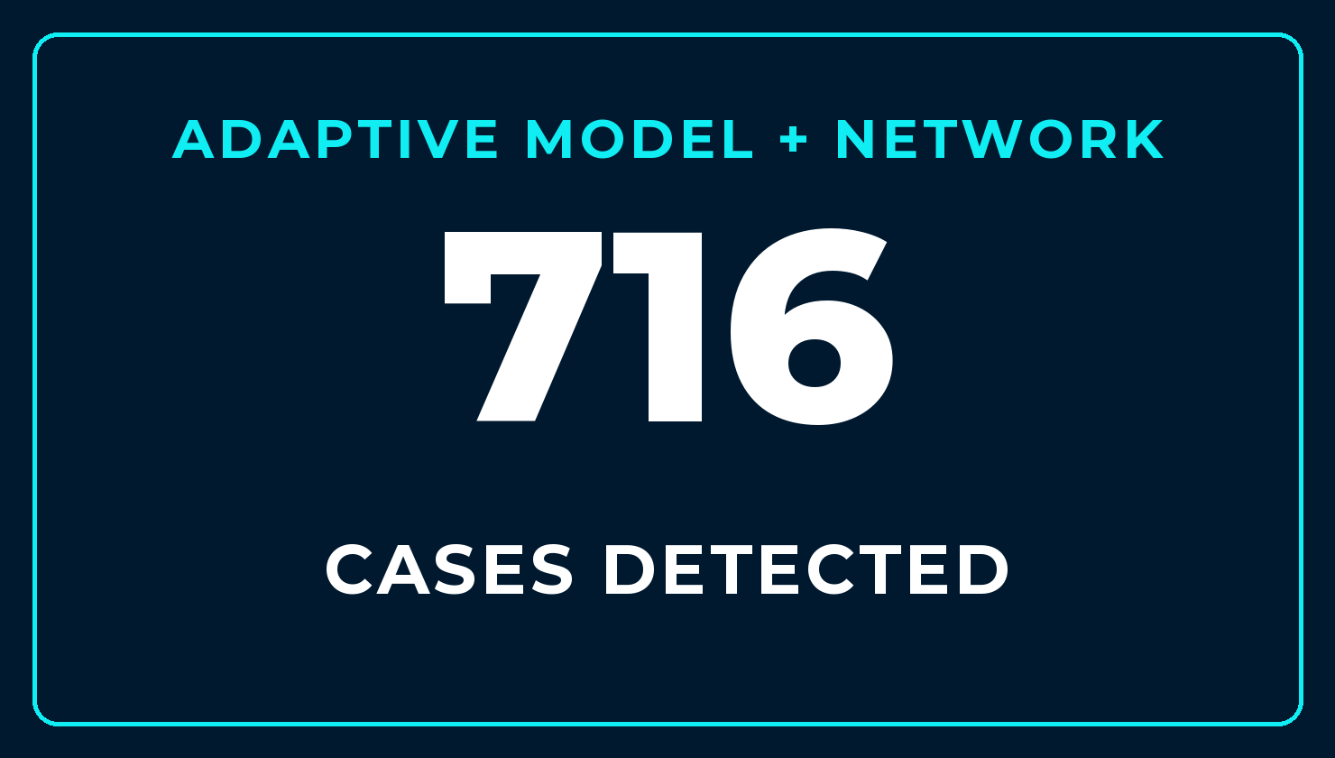
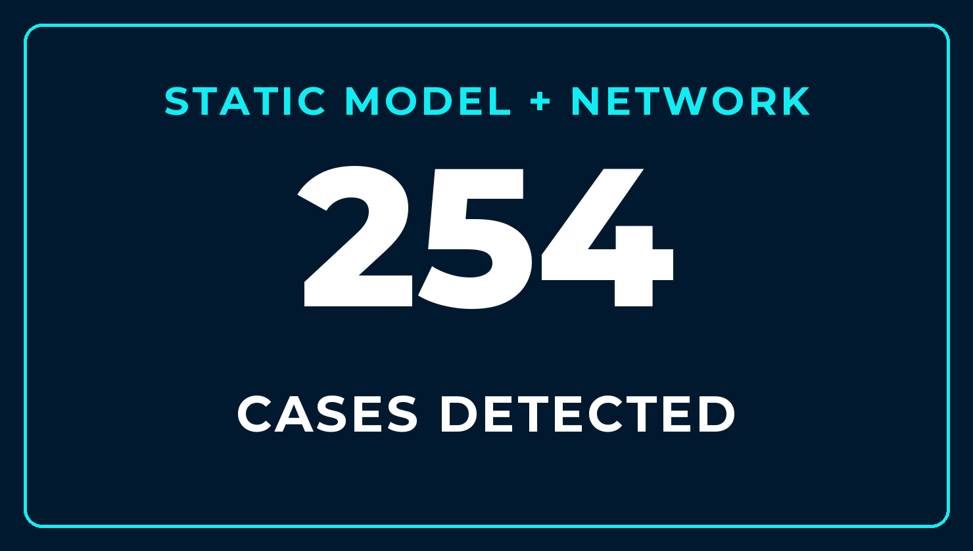
Monthly Retraining Doubled Detection Without Increasing Reviews In The Same Model
Kestrel Bank

Slide 9
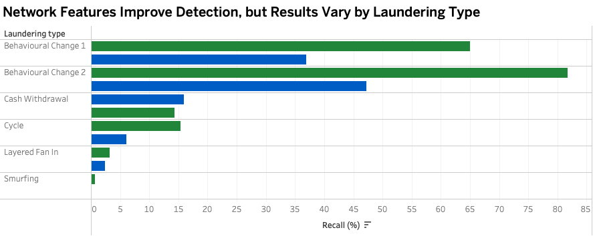
Network Context Improves Detection of Hidden Laundering Patterns
Rather than evaluating transactions in Isolation, the model examines how accounts interact, Identifying patterns of suspicious activity across connected accounts

Slide 10
How do we know these results are reliable?
Kestrel Bank
01
02
03
TIME BASED TESTING Models were developed on earlier data and evaluated on later transactions to simulate forward looking performance
.
Equal Review Capacity Every model was evaluated under the same review limit of 50 accounts per day over the 235 days.
.
Performance Across Time Results were tracked monthly to evaluate whether detection improvements presisited as transaction patterns change
.

Slide 11
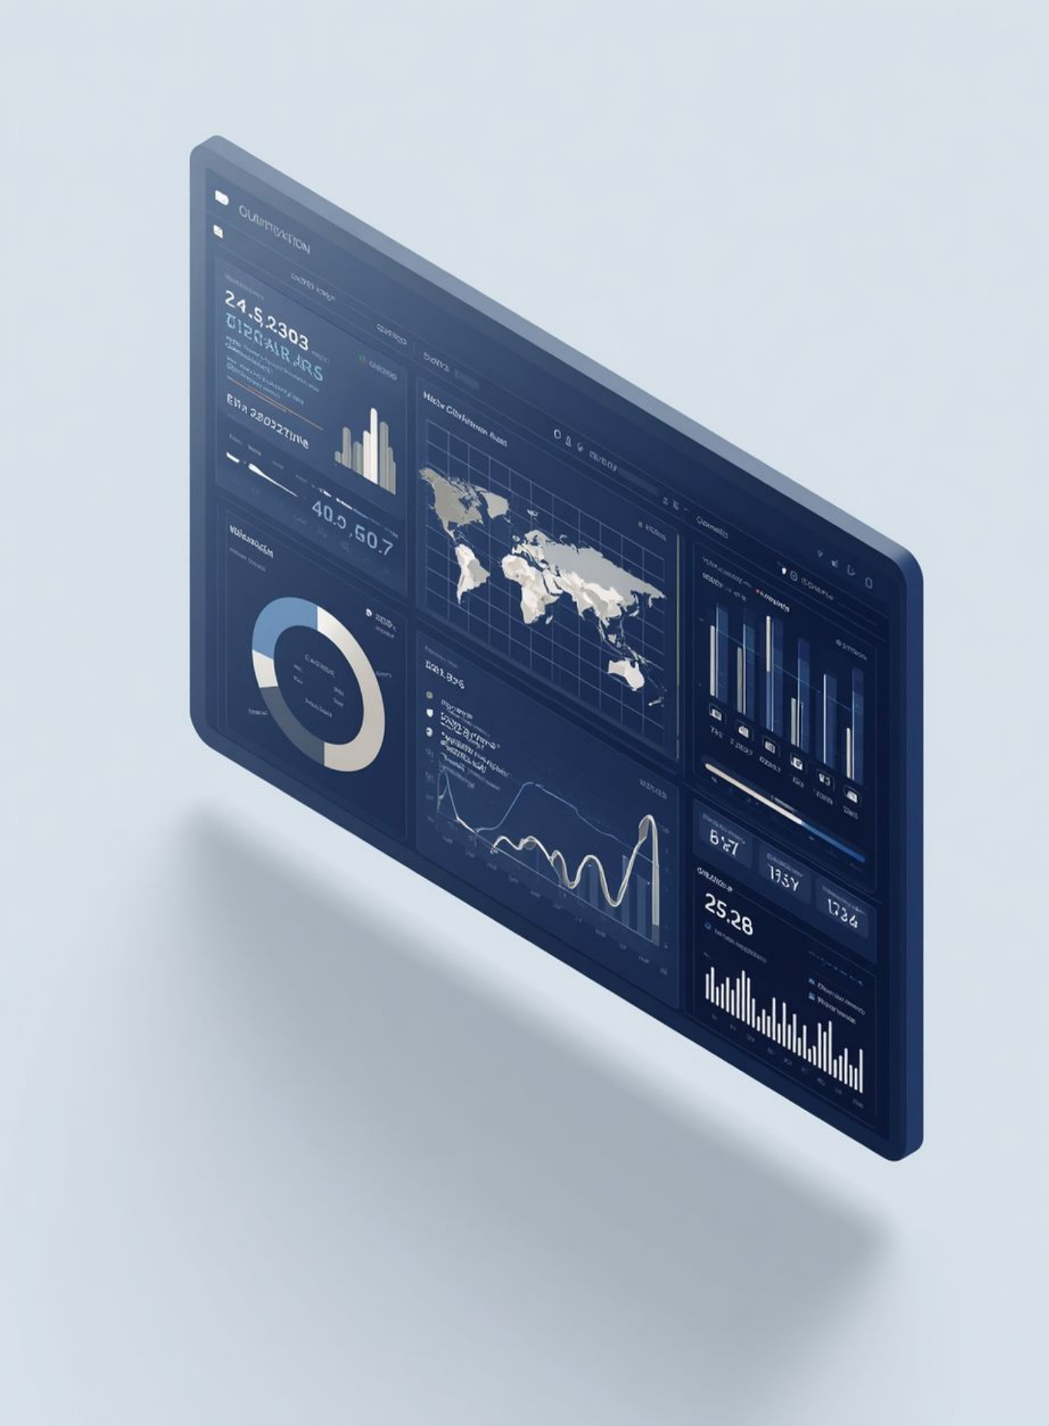

Thank You
QUESTIONS?
RYAN MCCLAIN
INFO 320 Final Project · VCU
GITHUB
github.com/ryanmcclain223/aml-alert-triage-analytics
EMAIL
mcclainr2@vcu.edu
Synthetic data; Kestrel Bank is fictional

